Slide 1

Introduction to R Programming
Mastering syntax, control flow, loops, and custom functions.
Levis Kitonge
MSc. Engineering Artificial Intelligence

Slide 2





THE ECOSYSTEM
Why Choose R?
Data Analysis
Vast Packages
Visualization
Powerful statistical techniques, clustering, and data reduction.
Thousands of open-source libraries for diverse problem-solving.
Easy generation of scatter plots, box plots, and histograms.
Platform Independent
Community Support
Runs seamlessly across Windows, macOS, and Linux environments.
Large, active community driving the hottest tech trends.

Slide 3

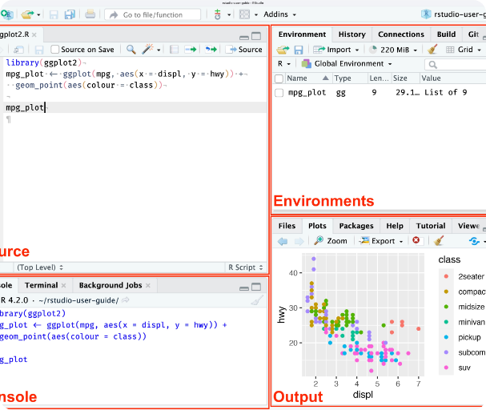
ENVIRONMENT SETUP
The RStudio Interface
Source/Scripts: Write and save reusable R code files.
Console: Execute code immediately and view standard output.
Environment: Track loaded variables, data frames, and functions.
Files/Plots/Packages: Manage directories, view charts, and install libraries.

Slide 4
FUNDAMENTALS
Core Data Types
Numeric
Integer
Character
Logical
Decimal values.
Whole numbers (Requires 'L').
Strings and text.
Boolean evaluations.
10.5
55.0
787.1
1L
55L
100L
"Hello"
"FALSE"
"11.5"
TRUE
FALSE

Slide 5
SYNTAX RULES
Variable Assignment
Legal Names
Illegal Names
Values are stored using the assignment operator.
Cannot start with numbers, contain hyphens, or use reserved words.
<-
myvar <- "John" my_var <- "John" MYVAR <- "John" .myvar <- "John"
2myvar <- "John" # Starts with number my-var <- "John" # Contains hyphen _my_var <- "John" # Starts with underscore TRUE <- "John" # Reserved word

Slide 6
LOGIC
Control Flow: If Statements
Standard if/else
Logical AND (&)
Logical OR (|)
Direct code execution paths using logical tests and relational operators.
Both conditional statements must be evaluated as true.
At least one conditional statement must be evaluated as true.
if (b > a) { print("b is greater") } else if (a == b) { print("Equal") } else { print("a is greater") }
if (a > b & c > a) { print("Both are true") }else{ print("Not true") }
if (a > b | a > c) { print("At least one true") }else{ print("False") }

Slide 7
ITERATION
Loops: While & For
While Loops
Iterating with For Loops
Execute a block of code continuously as long as a specified condition remains TRUE.
No predefined indexing variable required. Iterate sequentially over sets.
# Basic while loop with increment i <- 1 while (i <= 6) { print(i) i = i + 1 }
# Numeric Ranges for (x in 1:10) { print(x) } # List Items fruits <- list("apple", "banana") for (x in fruits) { print(x) }
break: Immediately terminates the entire loop cycle.
next: Skips the current iteration and advances.
Supports Nested Loops to run loops inside loops for complex combinations.

Slide 8
MODULARITY
Defining Functions
Code Reusability
Local Variables
Variables created inside a function are isolated. They cannot be used outside that function.
Reusable code blocks that accept parameters and return computed data.
# Define a function with arguments origin <- function(country = "Kenya") { paste("I am from", country) } # Return statement usage addition <- function(x, y) { add <- x + y return(add) } # Execution origin("Sweden") # Output: "I am from Sweden" addition(10, 5) # Output: 15
Global Variables
Created outside functions, or explicitly assigned globally using the operator.
<<-

Slide 9



INTERACTIVE SCRIPTS
Output & Strings
print() & cat()
paste() & nchar()
readline()
Display values and variables to the standard output console.
Concatenate strings together, or calculate total string character length.
Capture live keyboard input from users directly in the console.

Slide 10

Time to Practice
Open your R console and start experimenting with the provided script syntax.
Contact Details
+254 115 249 130
leviskitonge@gmail.com
https://www.linkedin.com/in/levis-kitonge/

Slide 11

Image Sources
https://docs.posit.co/ide/user/ide/get-started/images/rstudio-panes-labeled.jpeg
Source: docs.posit.co

